Slide 1

Point Clouds Importation
file importers #1, #2, #3, ...

Slide 2
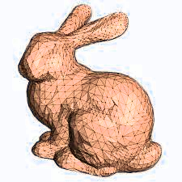
3D Mesh Reconstruction
mesher #1, #2, #3, ...

Slide 3
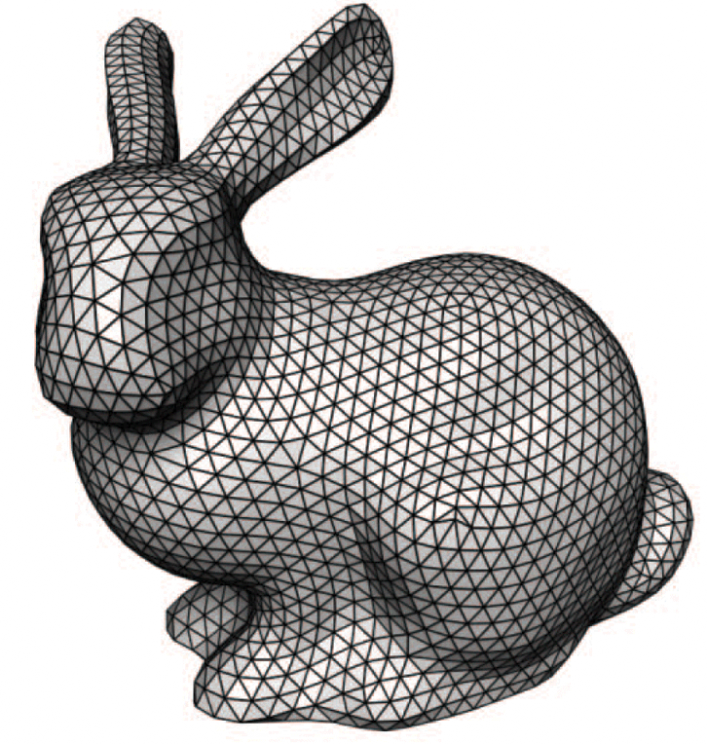
3D Mesh Repair and Smoothing
mesh repair tools, ...
mesh smoothers #1 #2, #3, ...

Slide 4
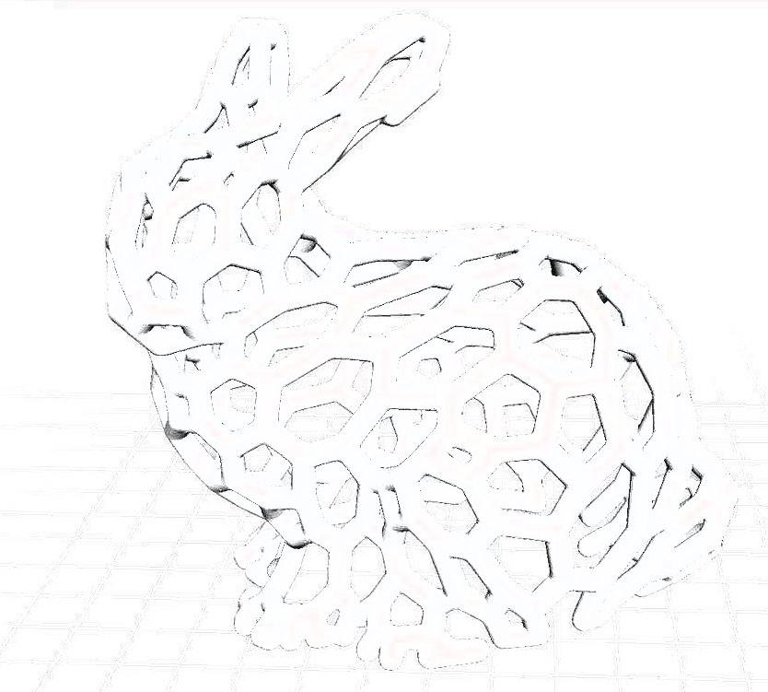
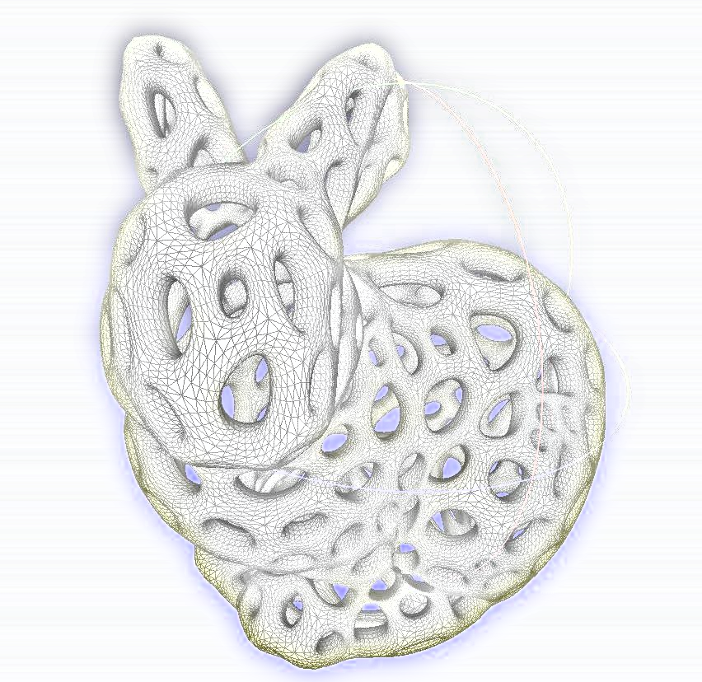
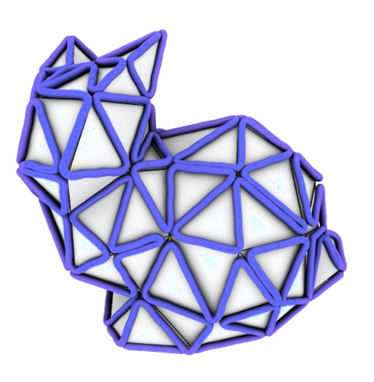


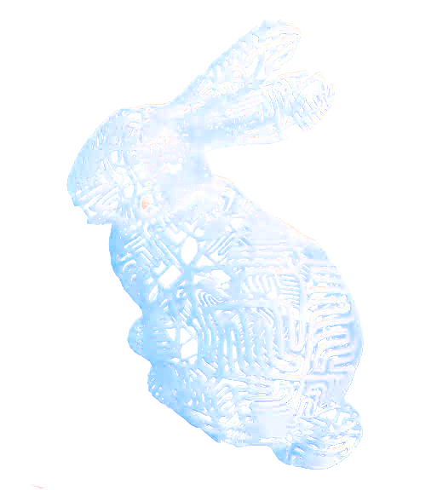
Variaty of Mesh Modifier Applications
mesh modifiers #1, #2, #3...
...
...

Slide 5
Visual Computing Platform
computing building blocks...
ponit cloud importer
mesh smoother #1
msher #1
mesh smoother #2
mesh merger #1
mesh smoother #3
mesh merger #2
mesh modifier #1
mesh simplifier #1
mesh modifier #2
mesh modifier #3
.stl exporter
.obj exporter

Slide 6
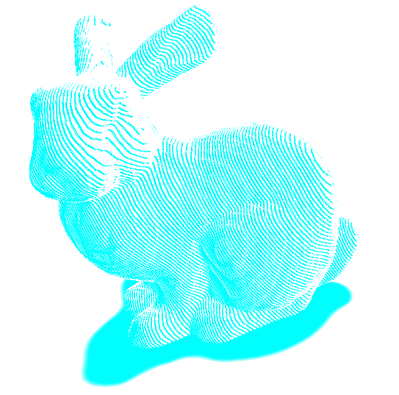
Slicing for 3D Printing
mesh slicers #1, #2, #3...

Slide 7
Web Portal
LOGIN
REGISTER
ONE COMPANY
PRODUCTS
SERVICES
GALLERIES
RESOURCES
ABOUT US

